Slide 1
CSC3423 – Biologically-Inspired Computing L01 – Introduction to the module
Jaume Bacardit
Jaume.bacardit@newcastle.ac.uk

Slide 2
Outline
Biological systems
Computational tasks
Brief overview of bio-inspired algorithms
Admin bits

Slide 3
Biology has many success stories
If we look at nature we see many cases of performing a variety of tasks very efficiently

Slide 4
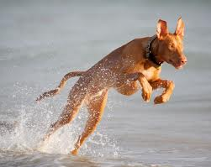
Moving animals

Slide 5
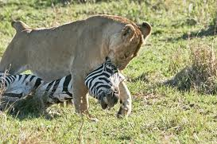
Feeding animals

Slide 6
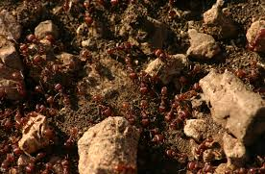
Ant colony

Slide 7
Common features
Information acquisition and processing
Calculating the right kind of behaviour
Abstract computation

Slide 8
Nature-inspired computing
Can we build computer programs inspired in how nature works?
Biologically-inspired computing!
What we will cover here is a set of algorithms that solve computer problems inspired in the way in which nature solves problems
We are not trying to emulate or simulate nature

Slide 9
What kind of problems are we talking about?
Optimisation
Machine learning
Modelling
Control
And others

Slide 10
Optimisation
Imagine that you need to find the shortest route that connects N cities without passing more than once through each city
Trade Salesman Problem (TSP)
You have to schedule the football games on Boxing day and New Year’s day
Minimising the distance that the fans have to travel
Avoiding clashes (e.g. Man Utd and Man City playing at home on the same day)

Slide 11
Optimisation
All these problems look different, but they have two things in common:
A specification of a candidate solution (i.e. a data structure)
City1 → City4 → City3 → City 1
A mathematical formula to assess how good is each candidate solution
Objective function (also known as fitness function)
Optionally, a list of constraints

Slide 12
Machine Learning
“Programs that automatically learn from experience” [Tom Mitchell]
A computer program that based on the ratings you give to movies, can recommend you new movies to see
In general, given large sets of data, building programs that find patterns in it

Slide 13
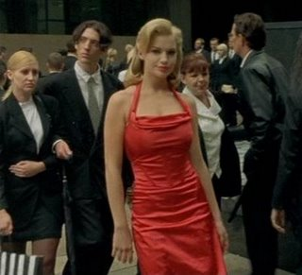
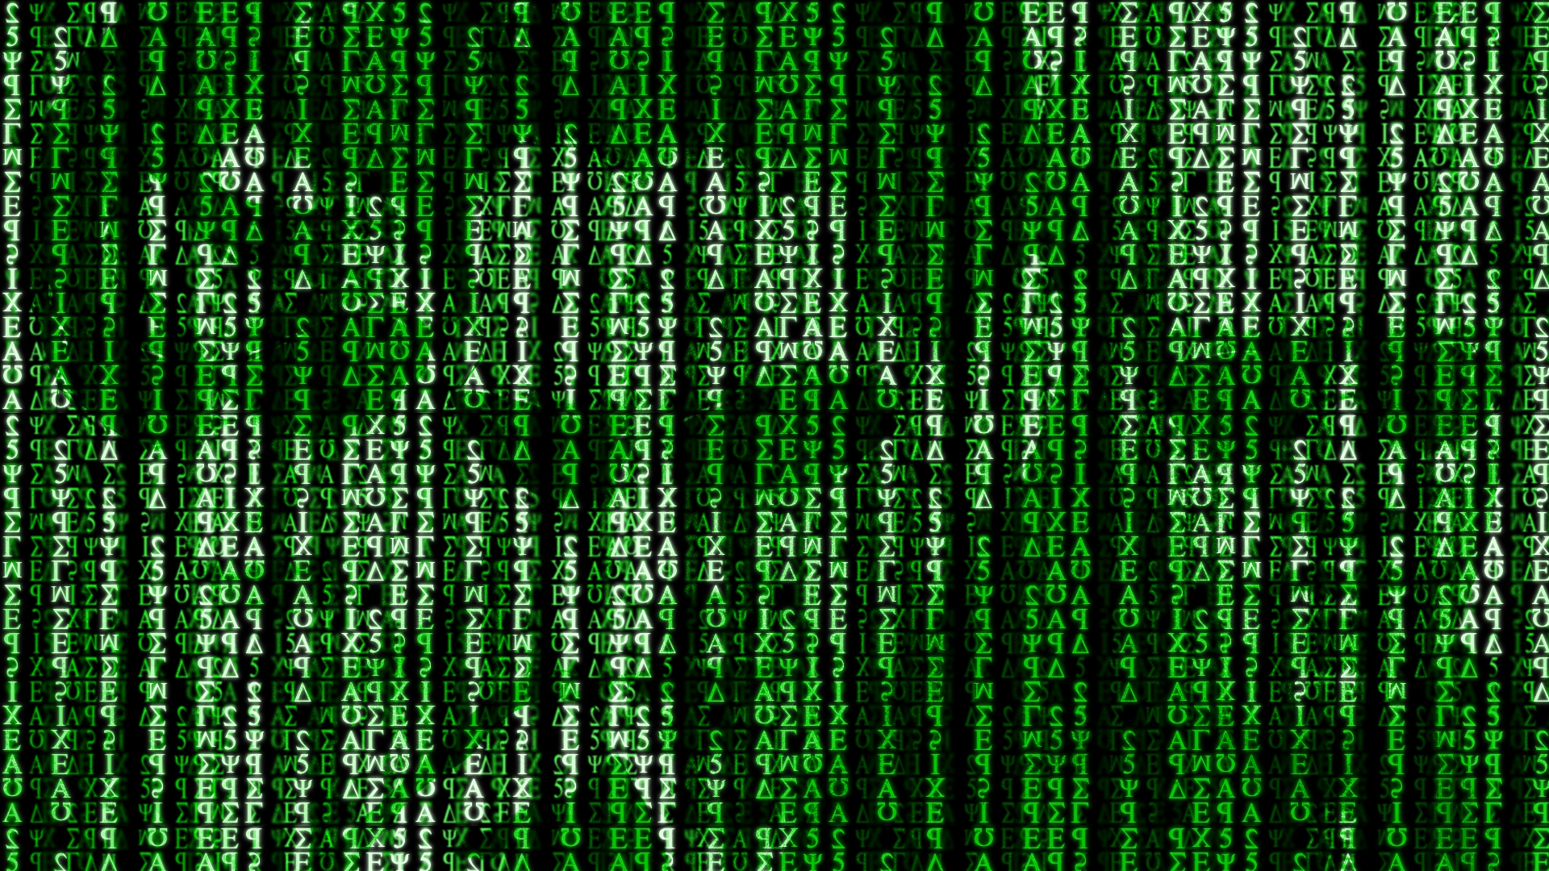
Remember Matrix?

Slide 14
What do you see in here?
If att3<1.257 and att4>1.741 then predict 3
If att3>1.746 and att4<1.252 then predict 3
If att3>1.748 and att4 in [1.495,1.771] then predict 3
If att3 in [1.487,1.750] and att4 in [1.248,1.504 then predict 3
If att3<1.263 and att4 in [1.250,1.487] then predict 3
If att3 in [1.250,1.515] and att4<1.258] then predict 3
If att3 in [1.501,1.746] and att4>1.743] then predict 3
If att3 in [1.249,1.499] and att4 in [1.497,1.752] then predict 3
If att3<1.250 and att4 in [1.250,1.507] then predict 3
Anything else -> predict 2
. . .

Slide 15
Modelling
Simulating how a system is going to change through time
System:
Set of components of the system
How the components interact between them
Modelling the functioning of a cell/organ/whole living organism
Modelling the traffic patterns of a city

Slide 16
Control
Build a computer program that learns how to drive a racing car (or play the game of GO)
Moving a robot in a manufacturing plant

Slide 17
Bio-inspired algorithms
Evolutionary Computation
Swarm Intelligence
Neural Networks
Cellular Automata
DNA Computing

Slide 18
Evolutionary Computation
A family of algorithms inspired in the process of evolution: adaptation of a set of individuals to an environment (natural selection)
Environment: objective function
Exploration of new solutions inspired by genetics

Slide 19
Swarm Intelligence
Algorithms that solve a problem by the coordinated effort by a set of agents
Agent: elements that explore the possible solutions to a problem
Key detail: there is no central coordination between these set of agents
Behavior is bottom-up
Several algorithms
Ant Colony Optimisation
Particle Swarm Optimisation
They can be applied to the same range of problems as EC

Slide 20
Artificial Neural Networks
A set of processing elements inspired in natural neuron(s) connected between them with a variety of patterns
Solving problems of learning/control
Classification
Controlling robots
Visual recognition
Deep Learning: ANNs on steroids
Hottest topic in AI
Inputs
Output

Slide 21
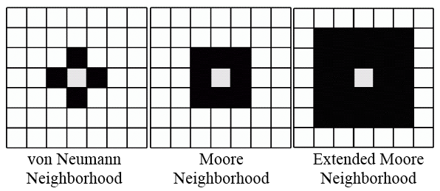
Cellular Automata
A discrete model for computing interactions between elements in a system.
Each element in the system is represented by cells oriented in an n-dimensional grid.
Defined by:
A neighborhood function.
A transition function
(set of rules).

Slide 22
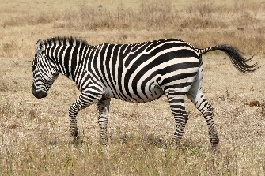



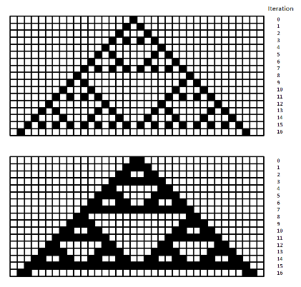
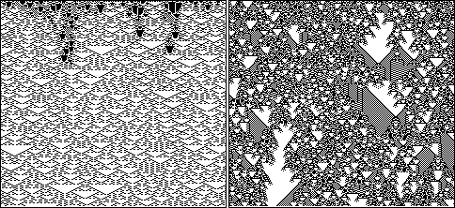
Applications of Cellular Automata
Pattern formation in biology.
Self-replication and artificial life.
Fractals.

Slide 23
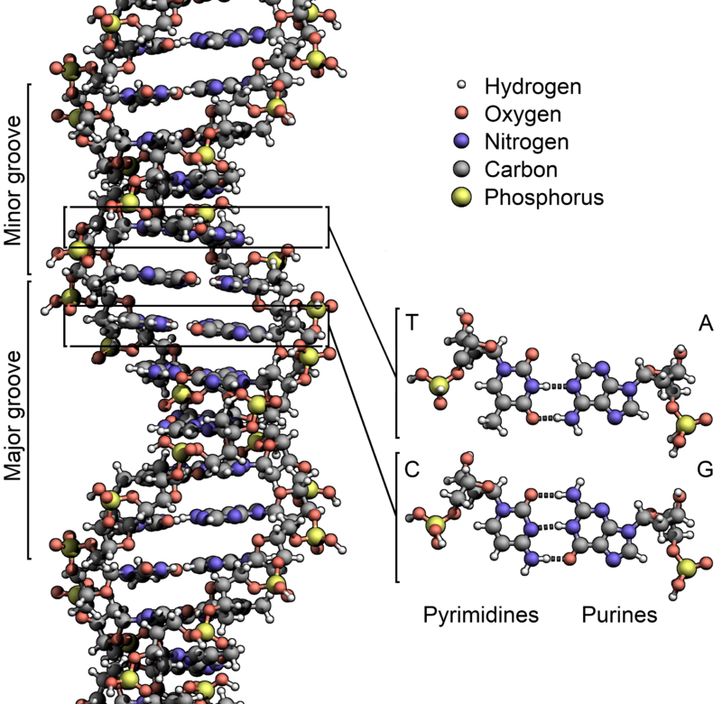
DNA computing
DNA molecules are constructing by chaining together four types (A, C, T and G) of molecules called nucleotides.
A strand of DNA can bind to another and create the famous double helix
A will only bind to T and C will only bind to G
With a combination of proteins and carefully designed DNA sequences theoretically any form of computation could be performed
Logic gates (AND, OR, NOT, XOR)
A TSP-esque problems
Turing Machines

Slide 24
And many more!
Membrane Computing
Artificial Immune Systems
Differential Evolution
Bat algorithms
Bee colony optimisation
Gravitational search
Dolphin Echolocation
Flower pollination algorithm
http://arxiv.org/abs/1307.4186

Slide 25
Admin bits
Lectures:
Mondays, 9:30 to 11:30, USB.4.005 SR
Practicals: Mondays, 11:30 to 12:30, USB.3.015 (B)
No practical on 30/9
Each practical focuses on a different type of nature-inspired algorithm, and they are all meant to support the two pieces of coursework
Coursework:
You will be provided with working bio-inspired algorithms for specific optimisation (coursework 1) and machine learning (coursework 2) tasks, which you will need to calibrate and experiment with
Each piece of CW is 25% of the module’s weight.
Check NESS for deadlines
Exam: 60 minutes (50% weight)

Slide 26
Changes since last year
Based on feedback from last year students the following changes to the module have been made:
The coursework specification has been refined to provide the right level of challenge but without adding excessive workload
Provide more examples in the lectures of why certain algorithms are used
Expanding the amount of machine learning content – guest lectures from NU deep learning researchers

Slide 27
Questions?

